Slide 1
Machine Learning for data science and business intelligence – 8IAR403
By Kévin Bouchard Ph.D.
Professor in artificial intelligence & machine learning
Laboratoire d'Intelligence Ambiante pour la reconnaissance d'activités (LIARA)
Université du Québec à Chicoutimi
www.Kevin-Bouchard.ca
Kevin_Bouchard@uqac.ca

Slide 2

Summary of lesson #4
You will learn about:
The basic components of the original Perceptron
How to train and use it
Linearity in machine learning

Slide 3
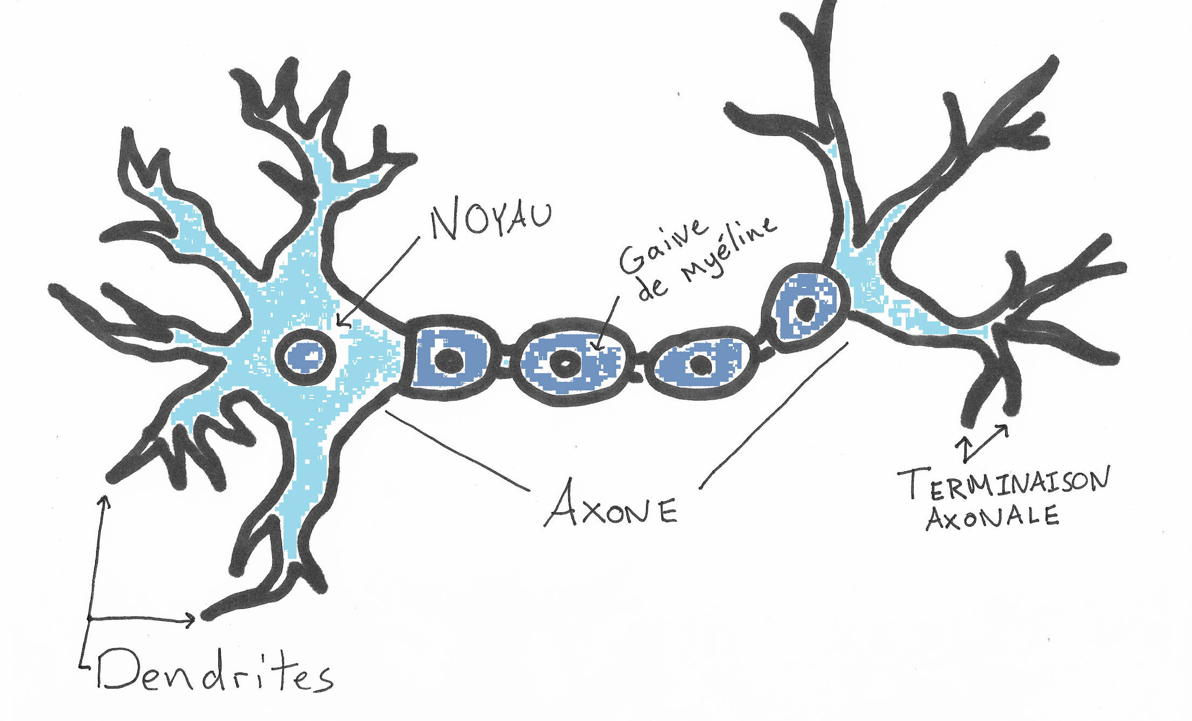
The original neural net
Return to 1943: McCullock & Pitts publish the MCP Neuron
A logical Calculus of the Ideas Immanent in Nervous Activity
The model describe interconnected nervous cells
They transmit electrical and chemical signals
Only a simple logical door!
Outputs
Inputs

Slide 4
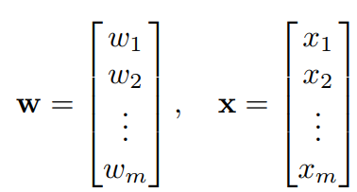

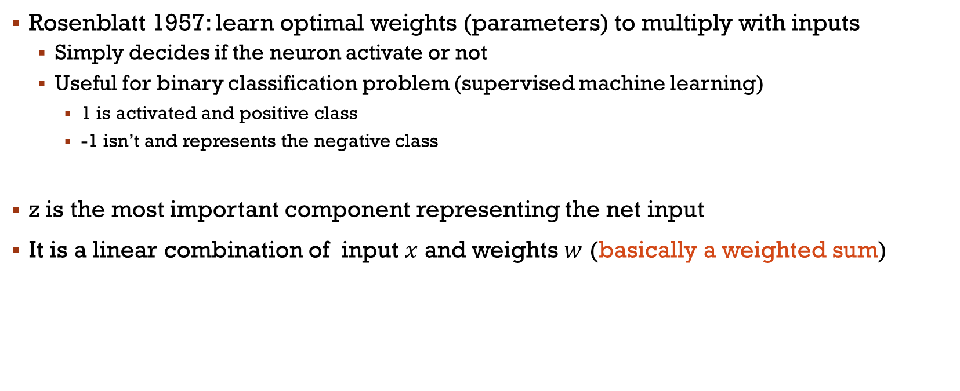
Perceptron
Rosenblatt 1957: learn optimal weights (parameters) to multiply with inputs
Simply decides if the neuron activate or not
Useful for binary classification problem (supervised machine learning)
1 is activated and positive class
-1 isn’t and represents the negative class
z is the most important component representing the net input
It is a linear combination of input $x$ and weights $w$ (basically a weighted sum)
Notes:
Phi et theta

Slide 5
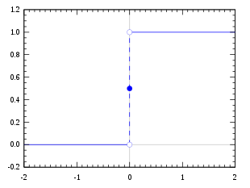
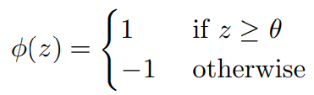
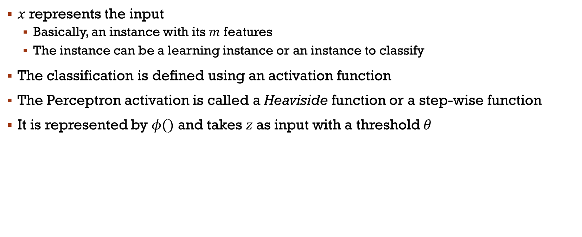
Perceptron
$x$ represents the input
Basically, an instance with its $m$ features
The instance can be a learning instance or an instance to classify
The classification is defined using an activation function
The Perceptron activation is called a Heaviside function or a step-wise function
It is represented by $φ()$ and takes $z$as input with a threshold $θ$
Notes:
Phi et theta

Slide 6
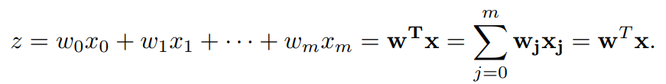
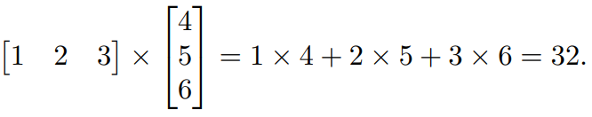
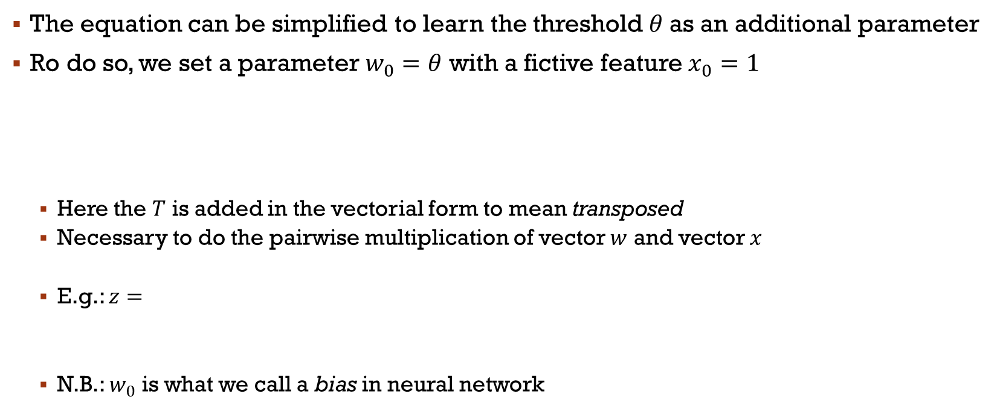
Perceptron (suite)
The equation can be simplified to learn the threshold $θ$as an additional parameter
Ro do so, we set a parameter $w_{0}=θ$ with a fictive feature $x_{0}=1$
Here the $T$ is added in the vectorial form to mean transposed
Necessary to do the pairwise multiplication of vector $w$ and vector $x$
E.g.: $z=$
N.B.: $w_{0}$ is what we call a bias in neural network

Slide 7
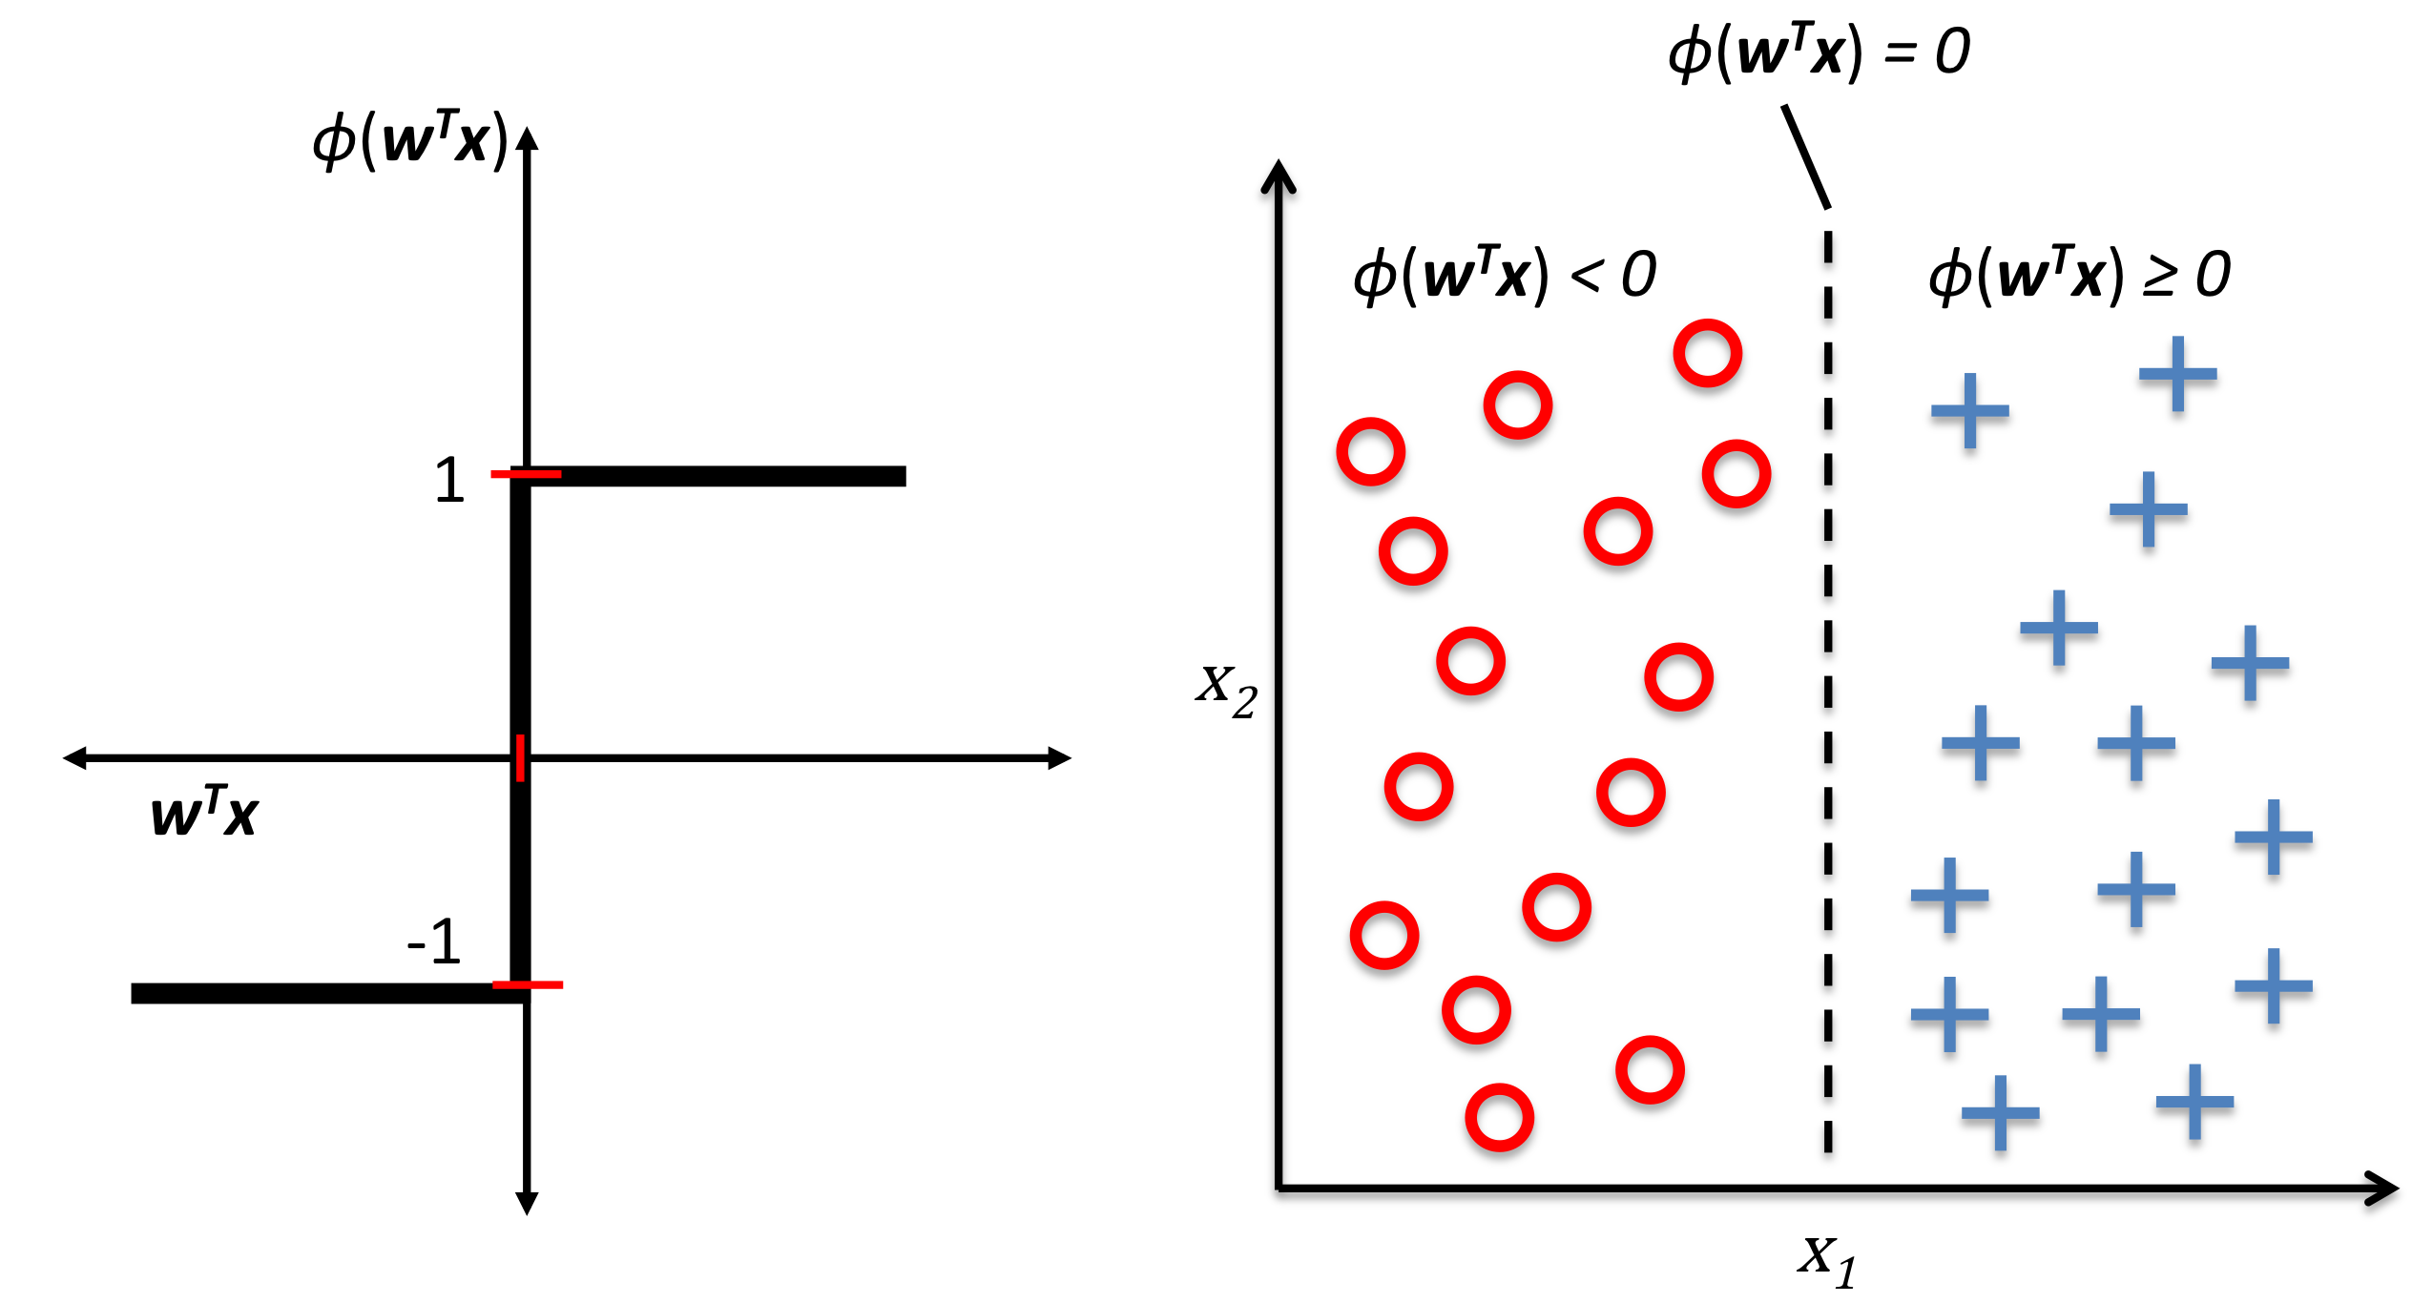
Perceptron visually

Slide 8
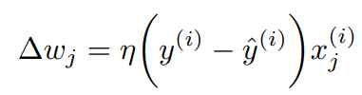
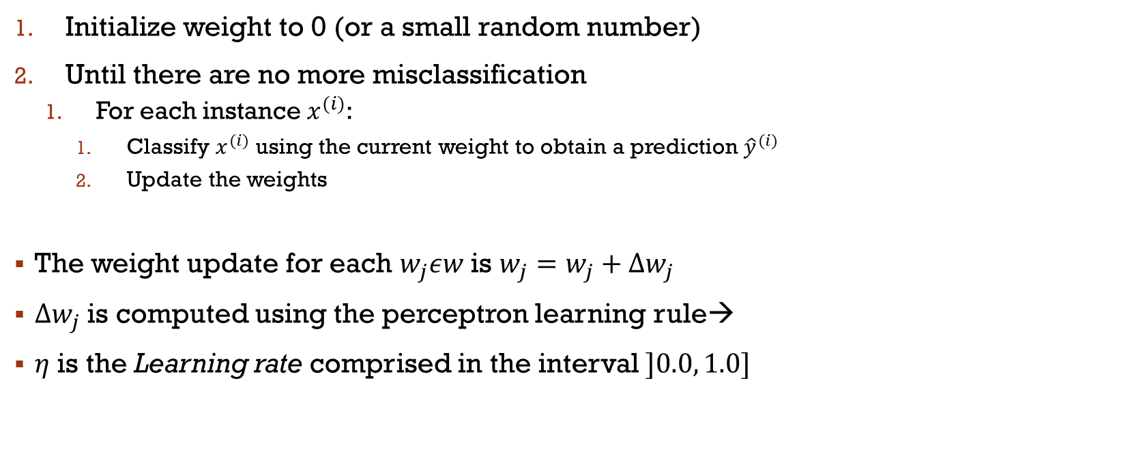
Training the Perceptron
Initialize weight to 0 (or a small random number)
Until there are no more misclassification
For each instance $x^{(i)}$:
Classify $x^{(i)}$ using the current weight to obtain a prediction ${\hat{y}}^{(i)}$
Update the weights
The weight update for each $w_{j}εw$ is $w_{j}=w_{j}+Δw_{j}$
$Δw_{j}$ is computed using the perceptron learning rule→
$η$ is the Learning rate comprised in the interval $]0.0, 1.0]$
Notes:
Hat= Estimated value n=eta

Slide 9
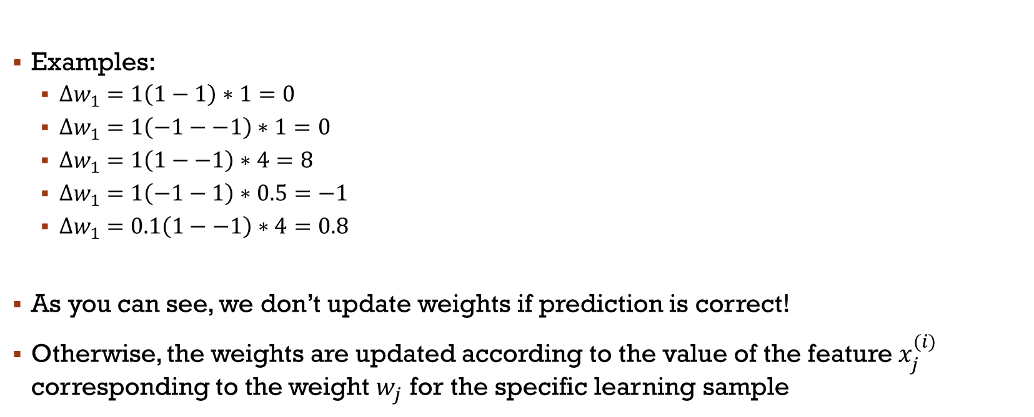
Training the Perceptron
Examples:
${Δw}_{1}=1\left(1−1\right)∗1=0$
${Δw}_{1}=1\left(−1−−1\right)∗1=0$
${Δw}_{1}=1\left(1−−1\right)∗4=8$
${Δw}_{1}=1\left(−1−1\right)∗0.5=−1$
${Δw}_{1}=0.1\left(1−−1\right)∗4=0.8$
As you can see, we don’t update weights if prediction is correct!
Otherwise, the weights are updated according to the value of the feature $x_{j}^{(i)}$ corresponding to the weight $w_{j}$ for the specific learning sample
Correct positive prediction!
Correct negative prediction!
Notes:
Example and Exercice HERE – image classification (detecting if a tic tac toe game has ended?)

Slide 10
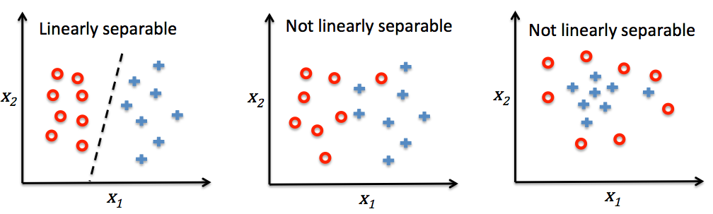
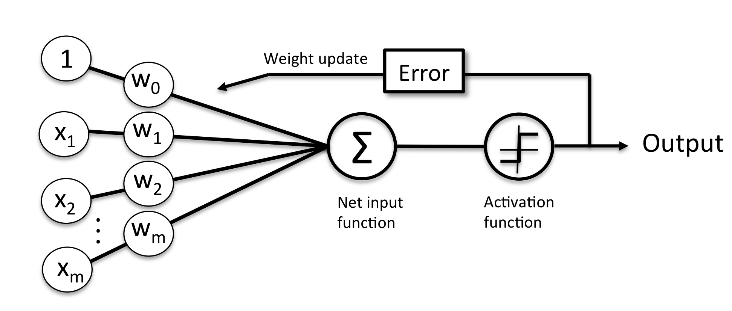
Conclusion
Overall, the original perceptron puts in place the main elements for neural networks
In ML, it is known as a linear model
Hence, it will only stop updating if the problem is linearly separable
Usually, a workaround is to set a maximal number of passage over the entire dataset
Notes:
VOIR CODE Python #1-Perceptron
Jouer avec hyper paramètres et mettre des points d’arrêts

Slide 11
Main References
Russell S., Norvig P., Artificial Intelligence: A Modern Approach. Prentice-Hall, Englewood Cliffs, 2021.
Aggarwal, C. C., Neural networks and deep learning. Springer, 2023.
Goodfellow I., Bengio Y., Deep Learning. The MIT Press, 2016.
Raschka S., Python Machine Learning, Packt Publishing, 2015.
Sutton R.S., Barto A.G., Reinforcement Learning: An Introduction, A Bradford Book, 2021.
Witten I.H., Frank E., Hall M.A., Pal C. Data Mining: Practical Machine Learning Tools and Techniques, Morgan Kaufmann, 2016.

